Slide 1
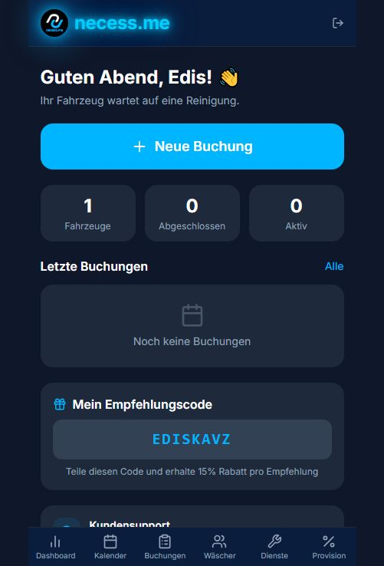
necess.me
Product preview
PITCH DECK
Marketplace and operating system for car care services.
Bookings, transparent pricing logic, washer assignment, referral growth and admin control in one product.
CHF
Fee
MVP
transparent price formation
simple revenue model per booking
Base44 app ready for pilot
necess.me
01

Slide 2
Problem
The car care market is local, fragmented and still too manual.
For car owners
For washers and detailers
For the platform
It is hard to quickly find trusted washers or detailers.
Pricing is often unclear before messaging or calling.
Scheduling still happens through chats, calls and waiting.
New customers arrive inconsistently across many channels.
Schedules, addresses and job statuses are often handled manually.
Scaling is difficult without a professional operating system.
Quality and availability need to be controllable.
Prices and discounts must be clear for customers.
Operations need to work from day one of the pilot.
necess.me
02

Slide 3
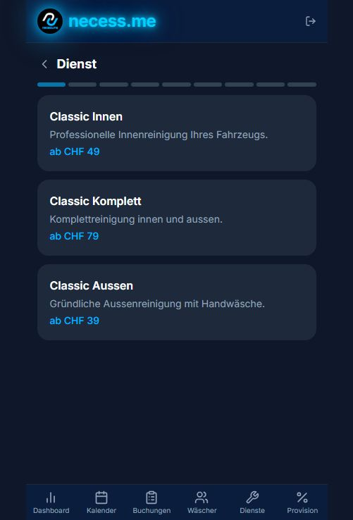
Solution
necess.me connects customer booking with operational control for car care services.
One product for both sides of the market
Booking flow
Customers choose service, vehicle size, service mode, address and time slot.
The system recommends the best available washer based on availability and profile.
Admin manages calendar, booking statuses, service catalog, washers and basic monetization.
Referral codes and discounts create a built-in growth loop.
necess.me
03

Slide 4
Product
The booking flow takes the user from need to confirmed reservation.
1
Service
2
Vehicle
3
Mode
Classic Interior, Complete or Exterior
Price adapts to vehicle class
Drop-off, mobile visit or pickup/drop-off
4
Time
5
Washer
6
Extras
Address, calendar and available slots
Automatic best-washer recommendation
Add-ons, referral discount and final price
The MVP already covers the core value: clear pricing, fewer messages and faster matching between demand and provider.
necess.me
04

Slide 5
Marketplace Dynamics
The platform can scale through better supply, better availability and referral growth.
Customers
Washers / detailers
Platform
Clear pricing
Fast slot selection
Mobile visit or pickup
Referral discount
New requests
Active / available status
Profile, rating and history
Scheduling without chaos
Service catalog
Dispatch logic
Operations calendar
Monetization and discounts
necess.me
05

Slide 6
Business Model
For external pitches, only basic monetization information is shared.
Booking Fee
Add-ons
Partner Tools
platform fee on successfully completed bookings
extra services increase booking value
future premium tools for partners and fleets
Basic logic
Pitch message
necess.me generates revenue when a booking is successfully completed.
The customer sees a clear price before confirming.
Add-on services, mobile visit and pickup/drop-off can increase booking value.
Specific fee levels are defined and tested during the pilot.
simple model
revenue tied to bookings
clear pricing for customers
flexible for the pilot phase
necess.me
06

Slide 7
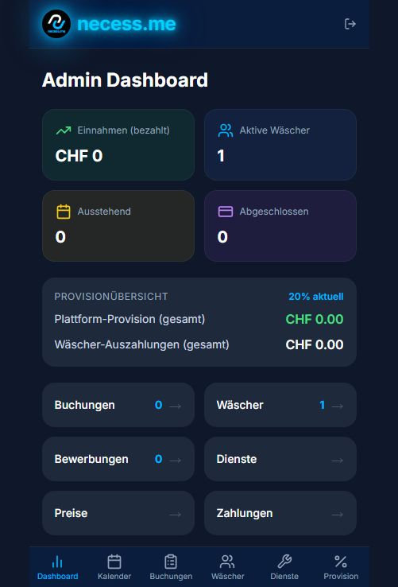
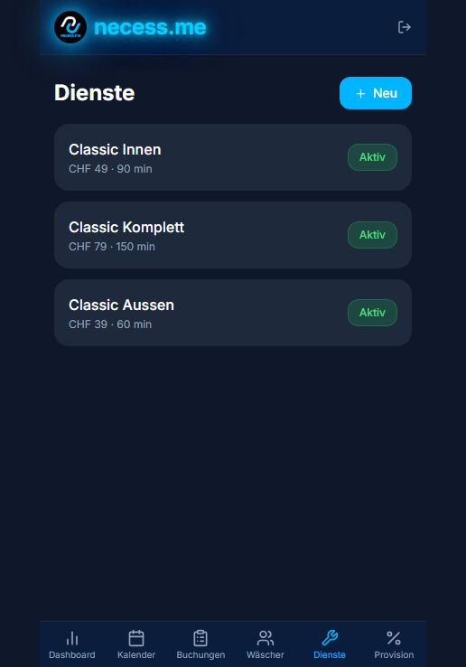
Operations
The admin layer turns a booking product into a manageable service business.
Admin dashboard
Service catalog
Control
bookings
washers
services
calendar
pricing
necess.me
07

Slide 8
Status
The MVP is functional and ready for a controlled pilot.
Built
Customer dashboard, vehicles, booking flow, referral code and support contact.
Operations
Admin dashboard, calendar, booking statuses, washer and service management.
Monetization
Platform fee per booking, add-on services and basic settlement logic.
Pilot setup
One active washer, three core services, CHF pricing and a test vehicle.
Next proof
First real bookings, repeat rate, referral acquisition and partner capacity.
necess.me
08

Slide 9
Beachhead Market
Start narrow, prove liquidity, then expand city by city.
Initial focus
Why now
Swiss urban regions with high purchasing power.
Car owners who want a clean process and clear pricing.
Mobile car care and pickup/drop-off as premium convenience.
B2B fleets, hotels, business locations and premium residential buildings as a second wave.
Customers expect booking experiences like delivery, taxi and beauty services.
Local providers need digital demand without building their own software.
No-code and AI make vertical marketplace testing faster.
Pilot data can quickly show where real demand exists.
necess.me
09

Slide 10
Go-to-Market
The pilot should prove repeatable demand and operational reliability.
1. Supply first
Onboard 10-20 vetted washers/detailers in one region; define quality standards, pricing and availability.
2. Local demand
Local SEO, Google Business, Instagram/TikTok content, QR flyers near parking locations and garage partnerships.
3. Referral loop
Use referral codes and discounts to measure which recommendations turn into bookings.
4. B2B channel
Offer fleets and property partners monthly slots and priority availability.
necess.me
10

Slide 11
Roadmap
From MVP to a platform that can launch across multiple cities.
Pilot
Automation
Partner scale
Growth
First real bookings, manual quality control, validation of price and capacity.
Online payment, confirmations, notifications, job statuses and reviews.
Washer onboarding, profile, availability management and partner analytics.
Multilingual app, fleet packages, CRM integrations and regional expansion.
necess.me
11

Slide 12
Ask
What is needed for the next 90 days.
Looking for
Pilot goal
Pilot partners: washers/detailers who can cover first appointments.
Local acquisition channels: garages, parking locations, fleets and properties.
Launch budget for first campaigns and operational validation.
Mentor/investor feedback on marketplace economics and pricing.
Prove that customers book without manual persuasion.
Measure how many bookings one washer can deliver with quality.
Test monetization and pricing under real conditions.
Reach a clear signal for expansion into the next city.
necess.me
necess.me
12

Slide 13
Appendix: MVP Features
Summary from the Base44 app review.
Client dashboard: vehicle, latest bookings, referral code and support info.
Booking: service, vehicle class, mode, address, calendar, time slot, washer, extras, referral and confirmation.
Admin: revenue, active washers, booking metrics and basic payout overview.
Operations: calendar, status filters, washer management, service catalog and basic pricing.
Note: market sizing and financial forecast are not invented in this version. Next step is to add validated Switzerland/DACH data and real pilot metrics.
necess.me
13

